Slide 1
An Introduction to Latent Dirichlet Allocation (LDA)
Tutorial
Zejun Li

Slide 2
CONTENTS
PART I Prerequisite
PART II: pLSA & LDA
PART III: LDA Training & Inference
PART IV: Language Model Evaluation
PART V: Applications

Slide 3
Prerequisite
Beta & Dirichlet Distribution
Conjugacy Distribution
MCMC & Gibbs Sampling
Statistical Language Model
Part I

Slide 4
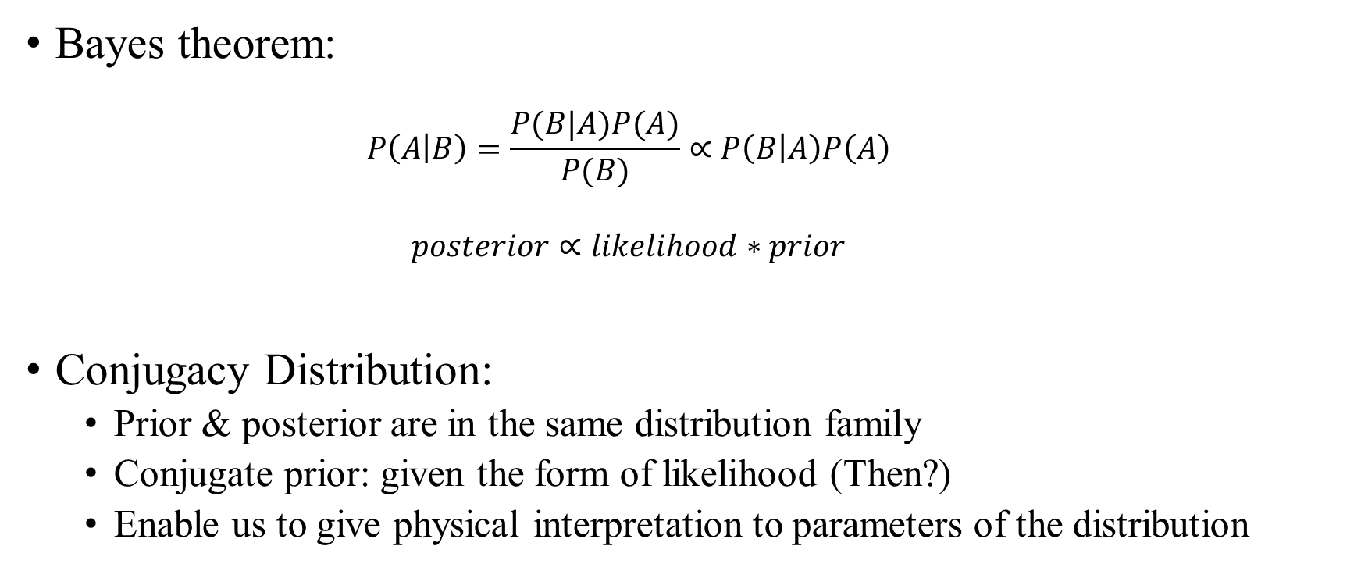
Bayesian inference and Conjugate Distribution
Bayes theorem:
$$P\left(A | B\right)=\frac{P(B|A)P(A)}{P(B)}∝P\left(B | A\right)P\left(A\right)$$
$$posterior∝likelihood∗prior$$
Conjugacy Distribution:
Prior & posterior are in the same distribution family
Conjugate prior: given the form of likelihood (Then?)
Enable us to give physical interpretation to parameters of the distribution

Slide 5

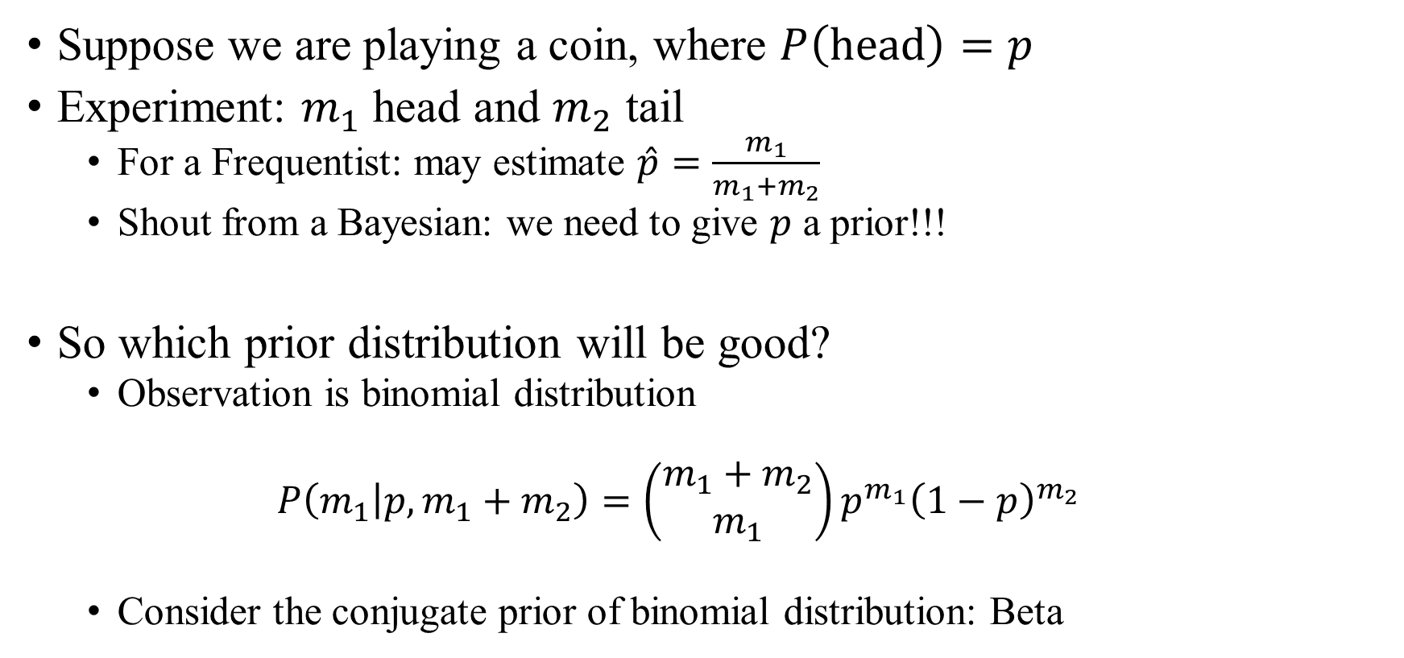
Illustrative Example: Beta-Binomial Conjugacy
Suppose we are playing a coin, where $P\left(\text{head}\right)=p$
Experiment: $m_{1}$ head and $m_{2}$ tail
For a Frequentist: may estimate $\hat{p}=\frac{m_{1}}{m_{1}+m_{2}}$
Shout from a Bayesian: we need to give $p$ a prior!!!
So which prior distribution will be good?
Observation is binomial distribution
$$P\left(m_{1} | p,m_{1}+m_{2}\right)=\left(\begin{matrix}m_{1}+m_{2} \\ m_{1}\end{matrix}\right)p^{m_{1}}{\left(1−p\right)}^{m_{2}}$$
Consider the conjugate prior of binomial distribution: Beta

Slide 6
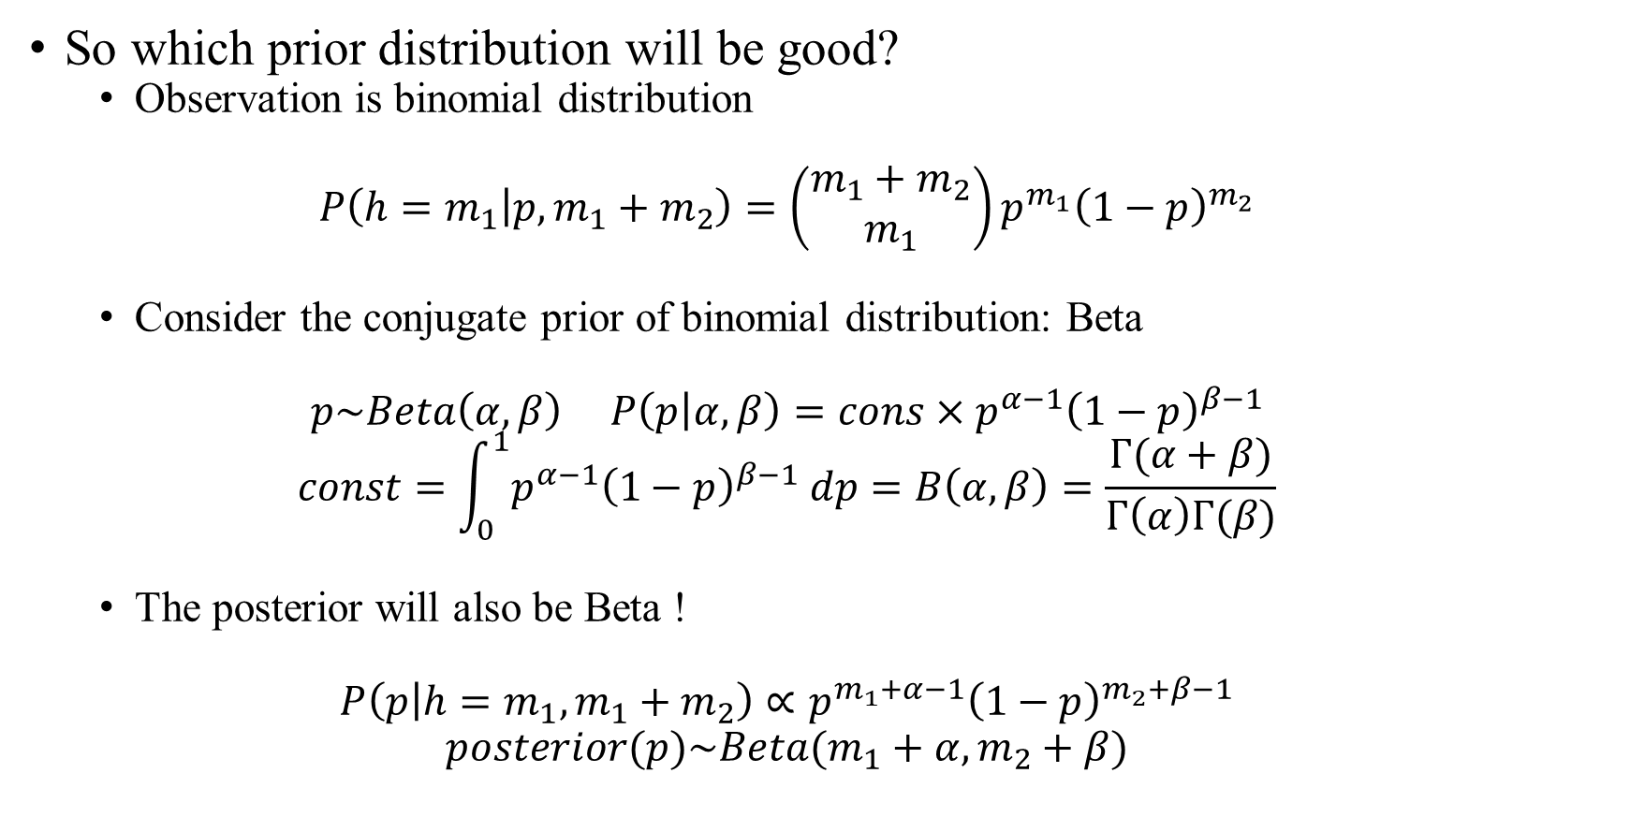
Illustrative Example: Beta-Binomial Conjugacy
So which prior distribution will be good?
Observation is binomial distribution
$$P\left(h=m_{1} | p,m_{1}+m_{2}\right)=\left(\begin{matrix}m_{1}+m_{2} \\ m_{1}\end{matrix}\right)p^{m_{1}}{\left(1−p\right)}^{m_{2}}$$
Consider the conjugate prior of binomial distribution: Beta
$$p\sim Beta\left(α,β\right) P\left(p | α,β\right)=cons×p^{α−1}{\left(1−p\right)}^{β−1}$$
$$const=\int_{0}^{1}{p^{α−1}{\left(1−p\right)}^{β−1} dp}=B\left(α,β\right)=\frac{Γ(α+β)}{Γ\left(α\right)Γ(β)}$$
The posterior will also be Beta !
$$P\left(p | h=m_{1},m_{1}+m_{2}\right)∝p^{m_{1}+α−1}{\left(1−p\right)}^{m_{2}+β−1}$$
$$posterior(p)\sim Beta(m_{1}+α,m_{2}+β)$$

Slide 7
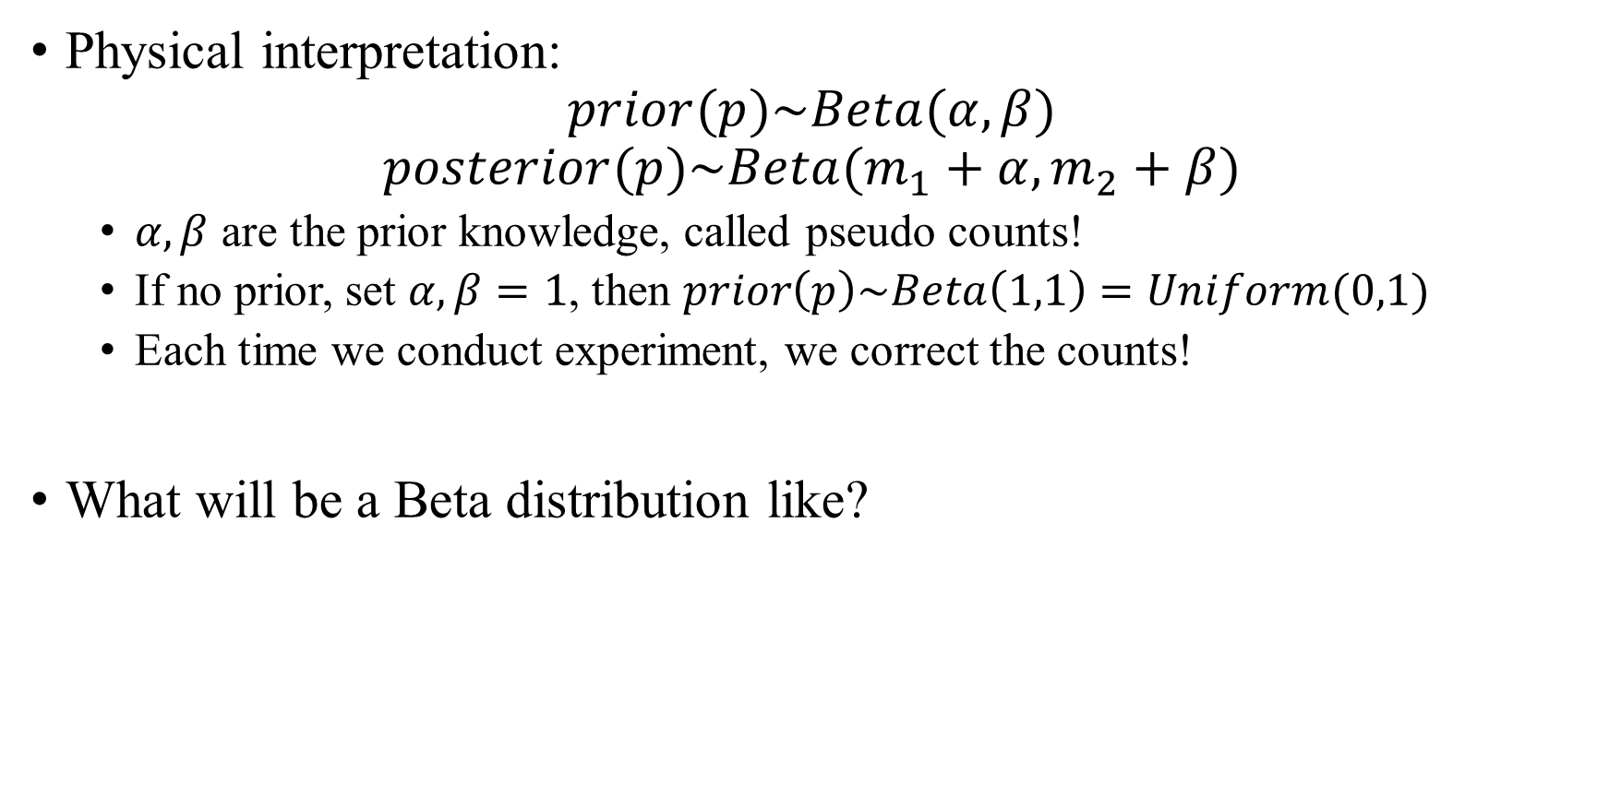
Illustrative Example: Beta-Binomial Conjugacy
Physical interpretation:
$$prior(p)\sim Beta(α, β)$$
$$posterior(p)\sim Beta(m_{1}+α,m_{2}+β)$$
$α, β$ are the prior knowledge, called pseudo counts!
If no prior, set $α,β=1$, then $prior\left(p\right)\sim Beta\left(1,1\right)=Uniform(0,1)$
Each time we conduct experiment, we correct the counts!
What will be a Beta distribution like?

Slide 8
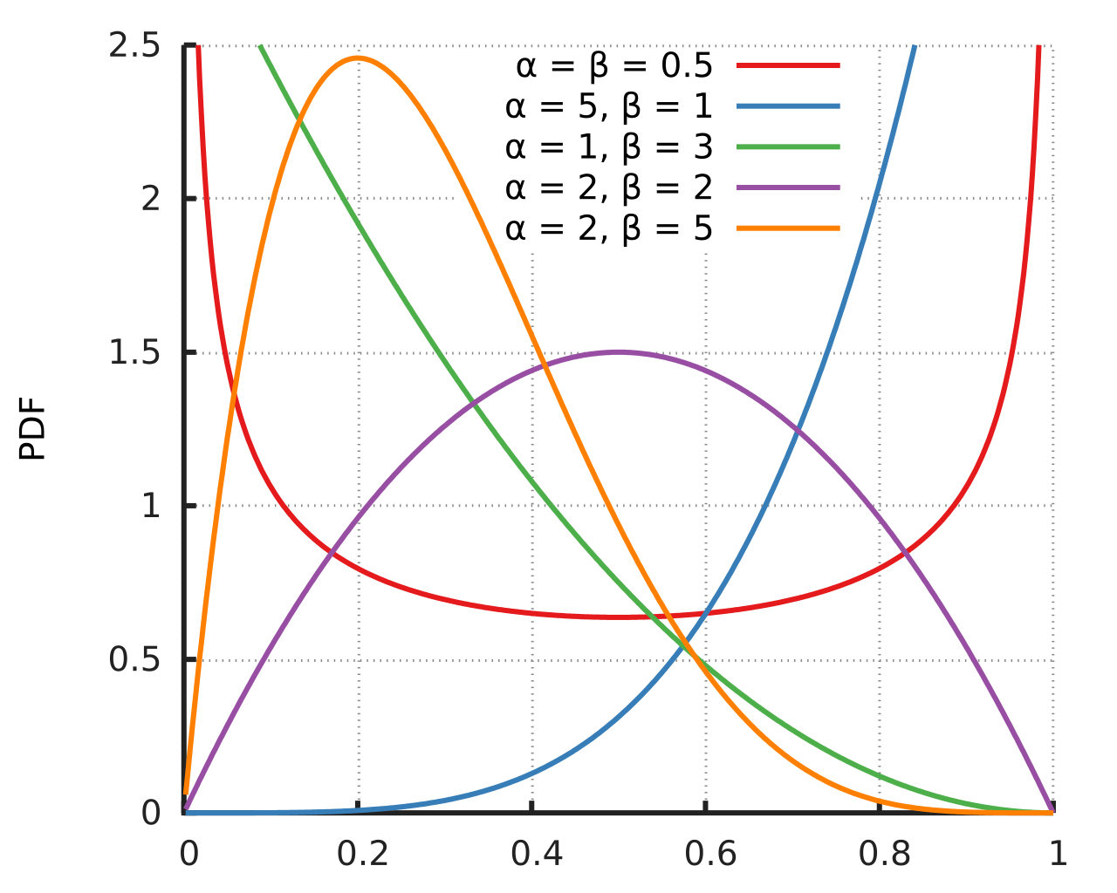
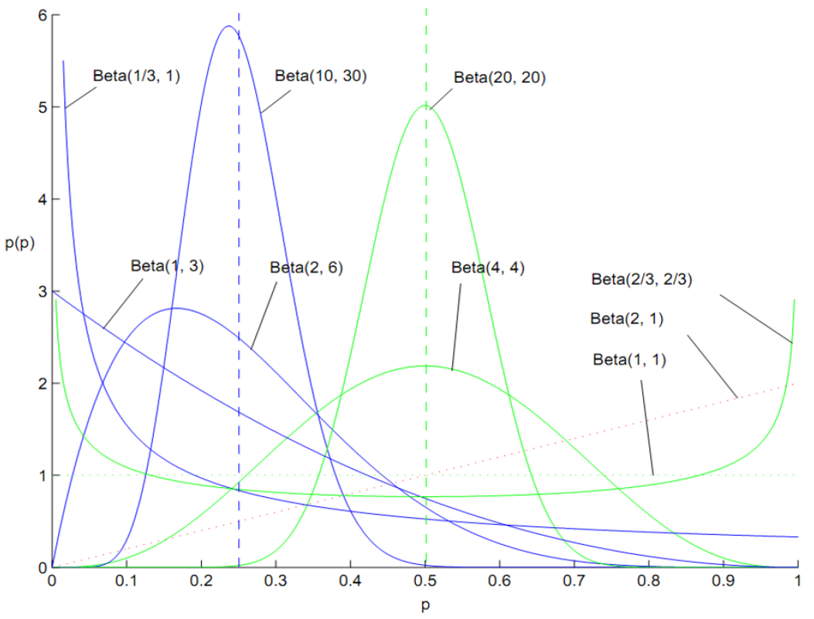
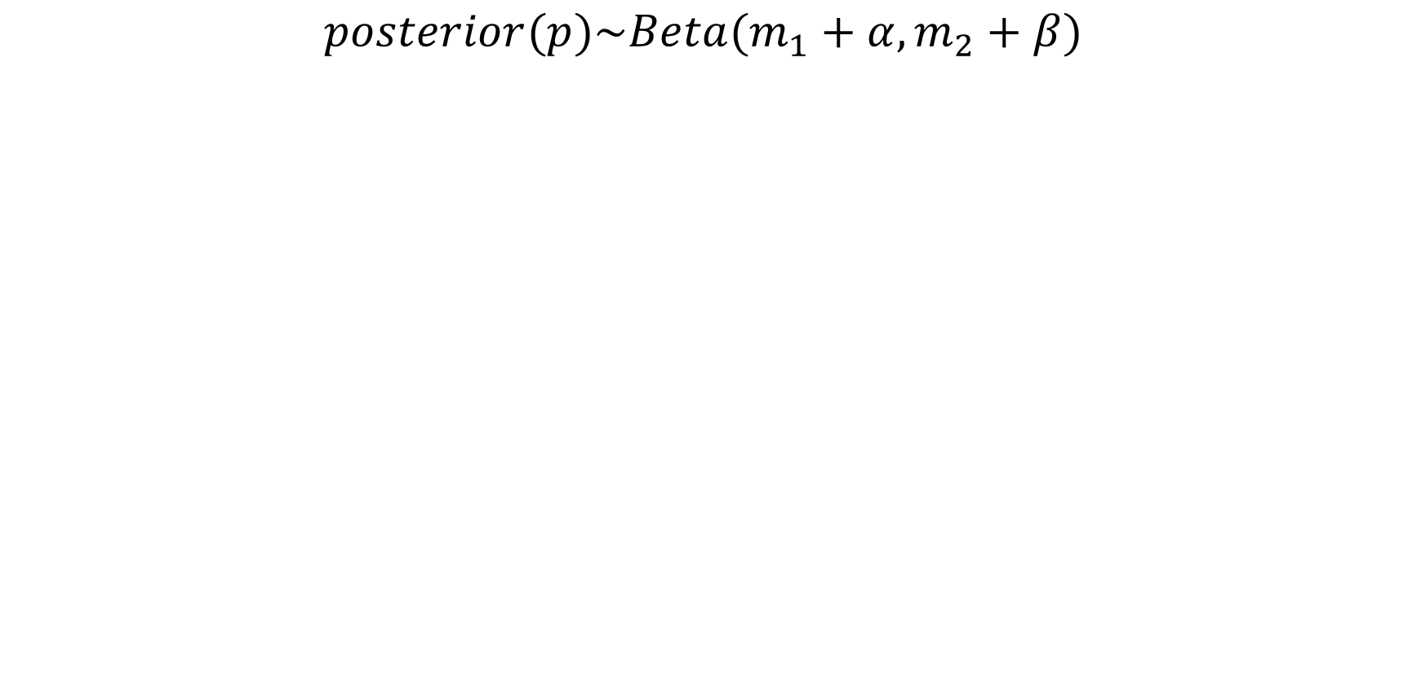
Illustrative Example: Beta-Binomial Conjugacy
$$posterior(p)\sim Beta(m_{1}+α,m_{2}+β)$$

Slide 9
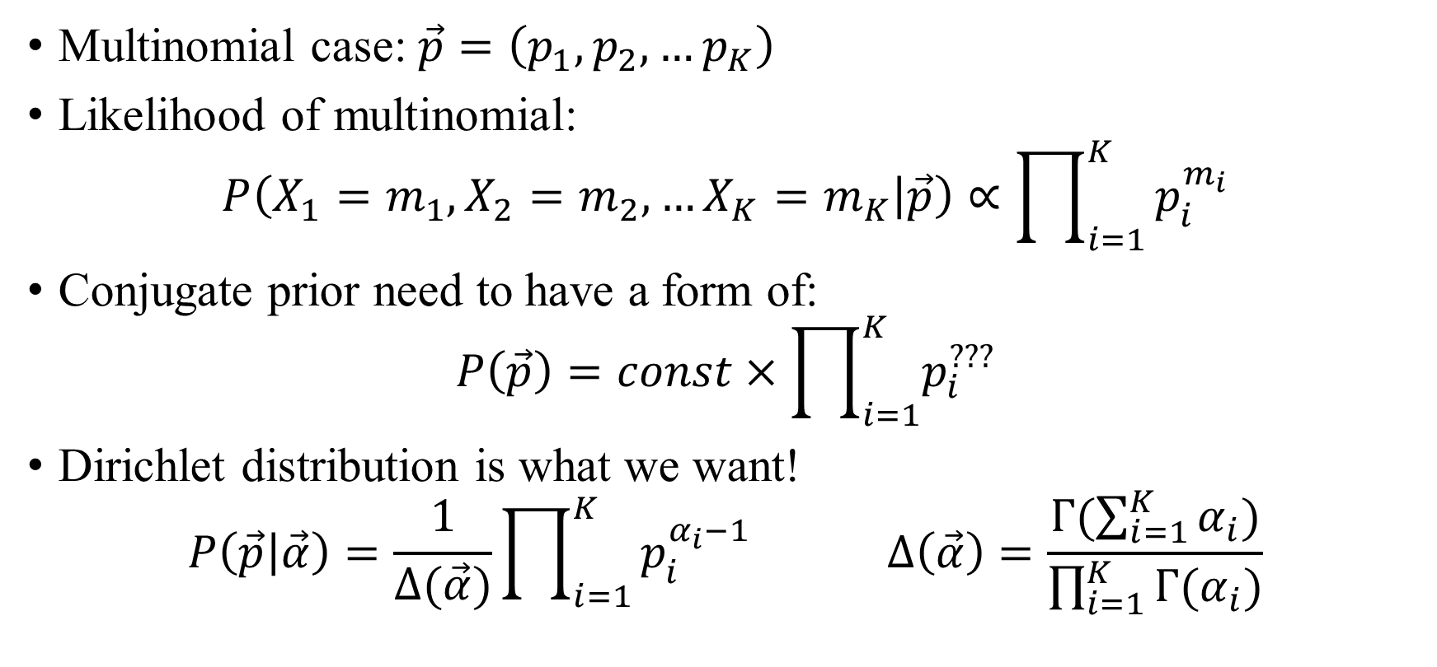
Dirichlet-Multinomial Conjugacy
Multinomial case: $\vec{p}=\left(p_{1},p_{2},…p_{K}\right)$
Likelihood of multinomial:
$$P\left(X_{1}=m_{1},X_{2}=m_{2},…X_{K}=m_{K} | \vec{p}\right)∝\prod_{i=1}^{K}{p_{i}^{m_{i}}}$$
Conjugate prior need to have a form of:
$$P\left(\vec{p}\right)=const×\prod_{i=1}^{K}{p_{i}^{???}}$$
Dirichlet distribution is what we want!
$$P\left(\vec{p} | \vec{α}\right)=\frac{1}{Δ(\vec{α})}\prod_{i=1}^{K}{p_{i}^{α_{i}−1}} Δ\left(\vec{α}\right)=\frac{Γ(\sum_{i=1}^{K}{α_{i}})}{\prod_{i=1}^{K}{Γ(α_{i})}}$$

Slide 10
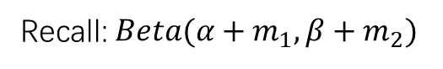
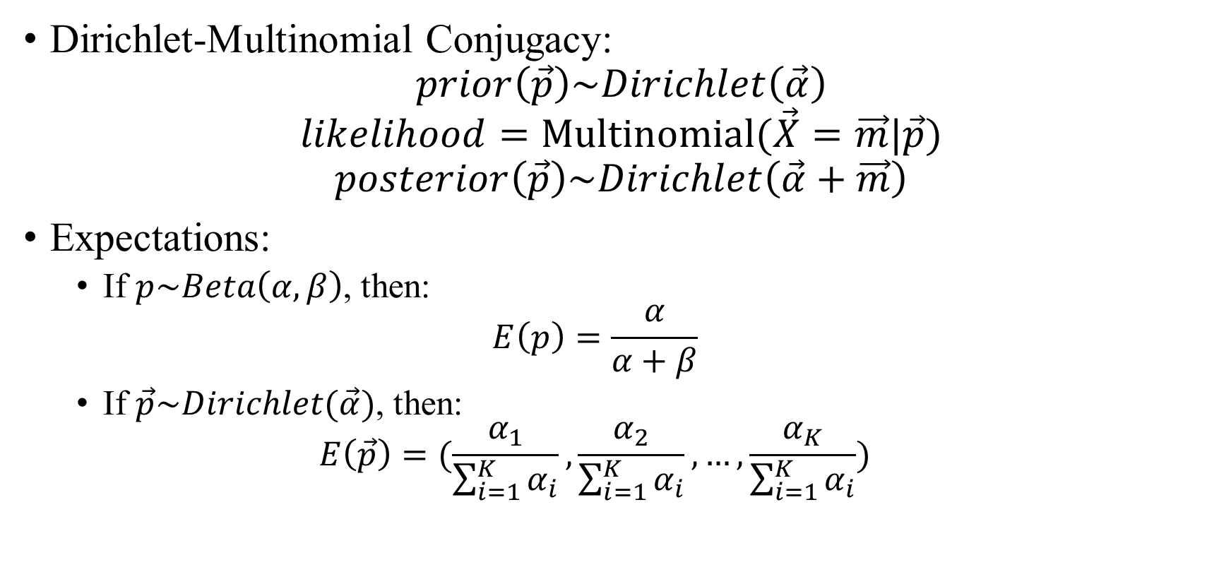
Moving On
Dirichlet-Multinomial Conjugacy:
$$prior\left(\vec{p}\right)\sim Dirichlet\left(\vec{α}\right)$$
$$likelihood=\text{Multinomial}\text{(}\vec{X}=\vec{m}|\vec{p}\text{)}$$
$$posterior\left(\vec{p}\right)\sim Dirichlet\left(\vec{α}+\vec{m}\right)$$
Expectations:
If $p\sim Beta\left(α,β\right)$, then:
$$E\left(p\right)=\frac{α}{α+β}$$
If $\vec{p}\sim Dirichlet(\vec{α})$, then:
$$E\left(\vec{p}\right)=(\frac{α_{1}}{\sum_{i=1}^{K}{α_{i}}},\frac{α_{2}}{\sum_{i=1}^{K}{α_{i}}},…,\frac{α_{K}}{\sum_{i=1}^{K}{α_{i}}})$$
Recall: $Beta(α+m_{1},β+m_{2})$

Slide 11
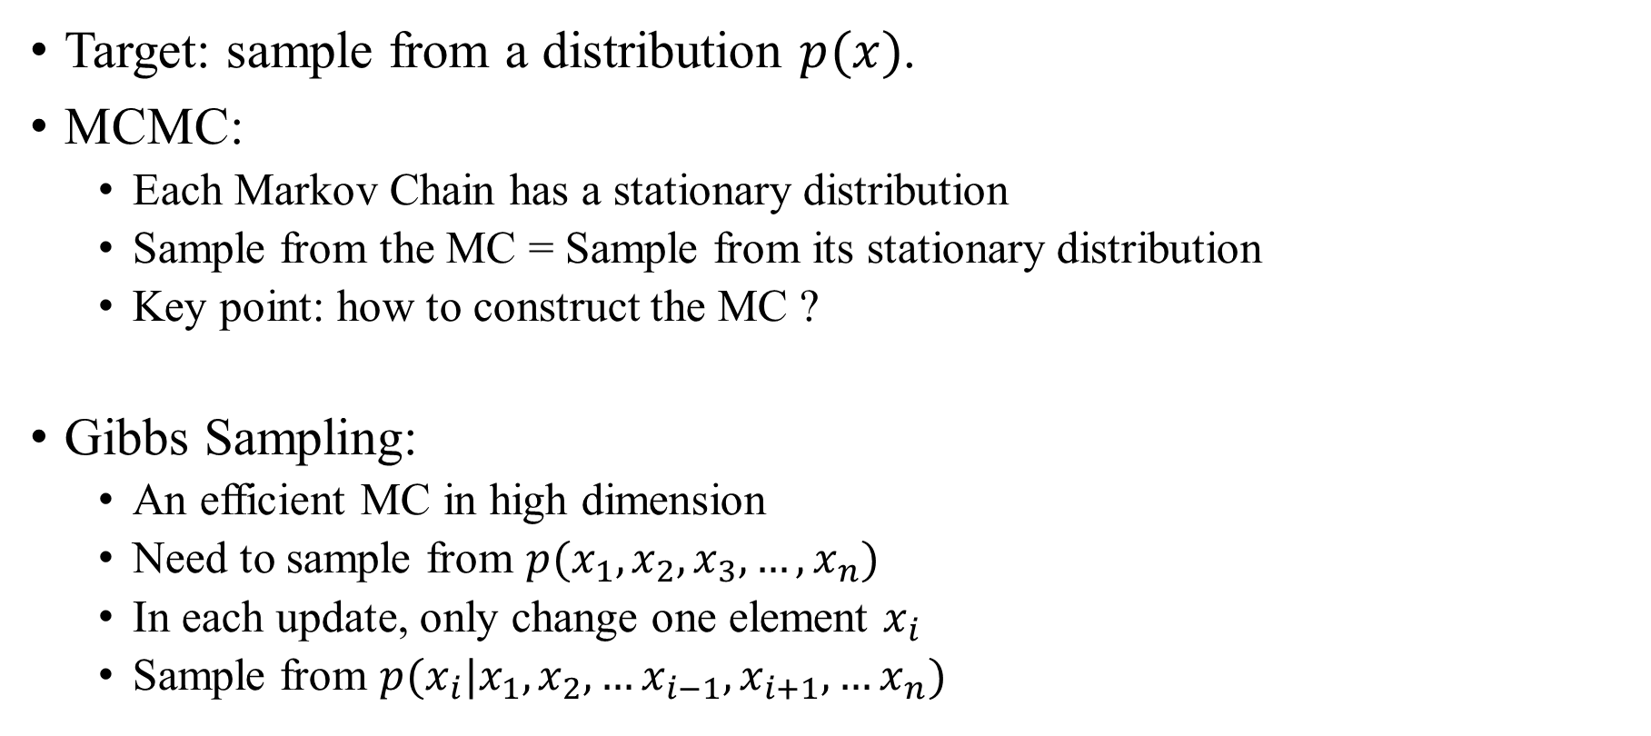
MCMC & Gibbs Sampling
Target: sample from a distribution $p(x)$.
MCMC:
Each Markov Chain has a stationary distribution
Sample from the MC = Sample from its stationary distribution
Key point: how to construct the MC ?
Gibbs Sampling:
An efficient MC in high dimension
Need to sample from $p(x_{1},x_{2},x_{3},…,x_{n})$
In each update, only change one element $x_{i}$
Sample from $p(x_{i}|x_{1},x_{2},…x_{i−1},x_{i+1},…x_{n})$

Slide 12
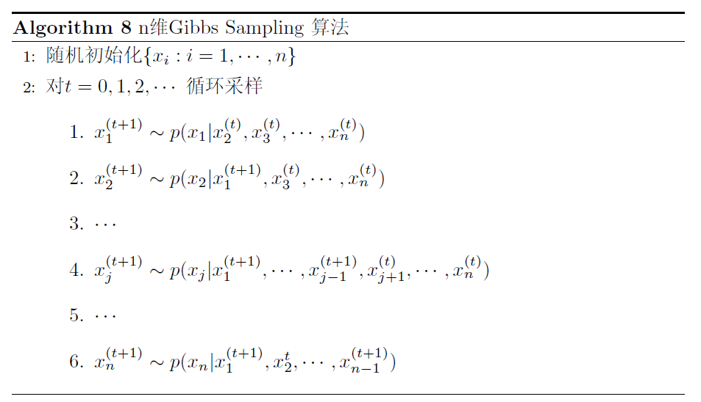
Gibbs Sampling

Slide 13
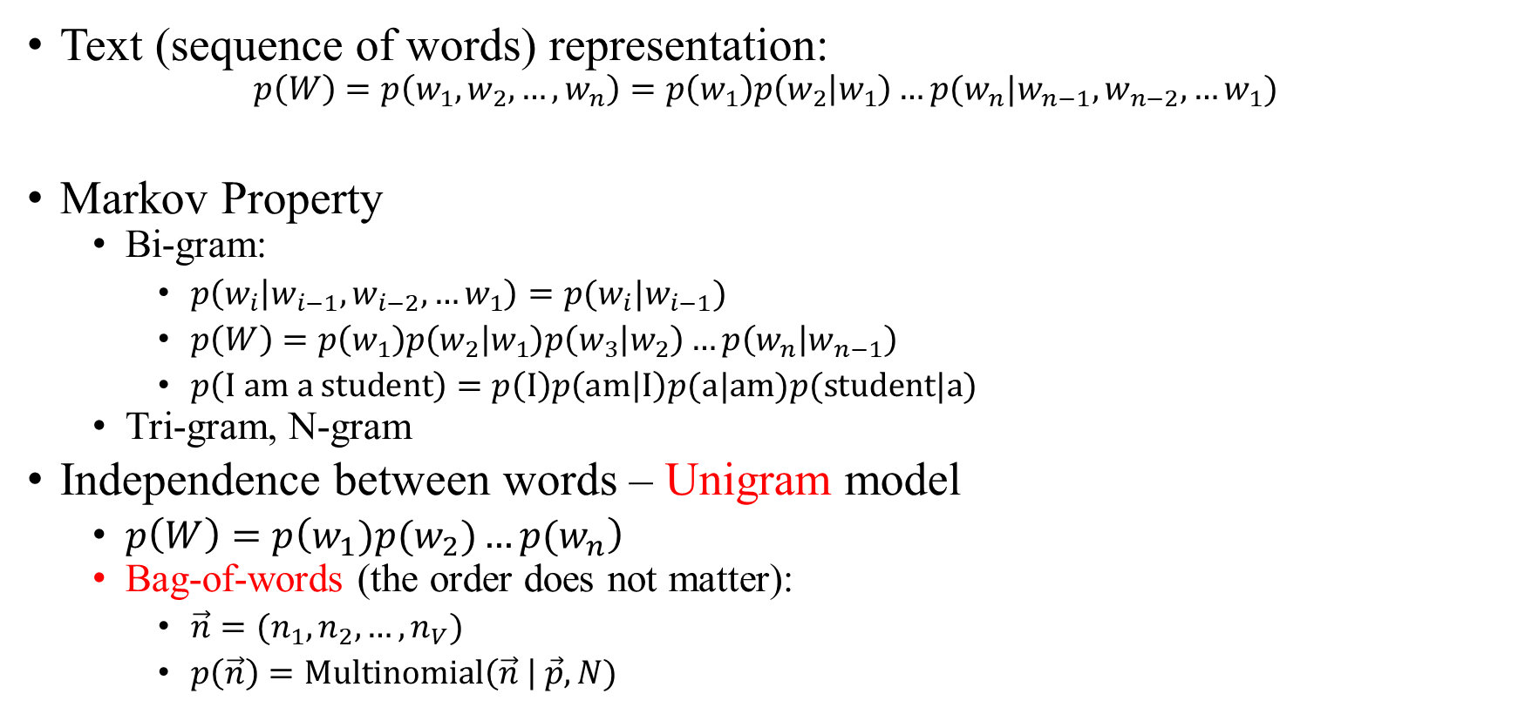
Statistical Language Model
Text (sequence of words) representation:
$$p\left(W\right)=p\left(w_{1},w_{2},…,w_{n}\right)=p\left(w_{1}\right)p\left(w_{2} | w_{1}\right)…p(w_{n}|w_{n−1},w_{n−2},…w_{1})$$
Markov Property
Bi-gram:
$p\left(w_{i} | w_{i−1},w_{i−2},…w_{1}\right)=p(w_{i}|w_{i−1})$
$p\left(W\right)=p\left(w_{1}\right)p\left(w_{2} | w_{1}\right)p\left(w_{3} | w_{2}\right)…p\left(w_{n} | w_{n−1}\right)$
$p\left(\text{I} \text{am} \text{a} \text{student}\right)=p\left(\text{I}\right)p\left(\text{am} | \text{I}\right)p(\text{a}\text{|}\text{am})p(\text{student}|\text{a})$
Tri-gram, N-gram
Independence between words – Unigram model
$p\left(W\right)=p\left(w_{1})p(w_{2})…p(w_{n}\right)$
Bag-of-words (the order does not matter):
$\vec{n}=(n_{1},n_{2},…,n_{V})$
$p\left(\vec{n}\right)=\text{Multinomial}\left(\vec{n} \right| \vec{p},N)$

Slide 14
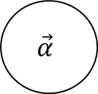
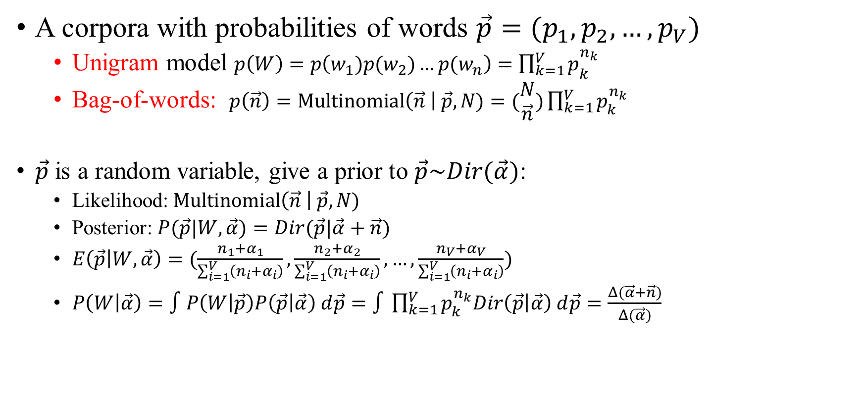
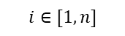
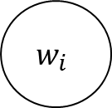
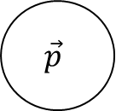
Statistical Language Model
A corpora with probabilities of words $\vec{p}=(p_{1},p_{2},…,p_{V})$
Unigram model $p\left(W\right)=p\left(w_{1})p(w_{2})…p(w_{n}\right)={\prod_{k=1}^{V}{p}}_{k}^{n_{k}}$
Bag-of-words: $p\left(\vec{n}\right)=\text{Multinomial}\left(\vec{n} \right| \vec{p},N)=(\begin{matrix}N \\ \vec{n}\end{matrix})\prod_{k=1}^{V}{p_{k}^{n_{k}}}$
$\vec{p}$ is a random variable, give a prior to $\vec{p}\sim Dir(\vec{α})$:
Likelihood: $\text{Multinomial}\left(\vec{n} \right| \vec{p},N)$
Posterior: $P(\vec{p}|W,\vec{α})=Dir(\vec{p}|\vec{α}+\vec{n})$
$E\left(\vec{p} | W,\vec{α}\right)=(\frac{n_{1}+α_{1}}{\sum_{i=1}^{V}{\left(n_{i}+α_{i}\right)}},\frac{n_{2}+α_{2}}{\sum_{i=1}^{V}{\left(n_{i}+α_{i}\right)}},…,\frac{n_{V}+α_{V}}{\sum_{i=1}^{V}{\left(n_{i}+α_{i}\right)}})$
$P\left(W | \vec{α}\right)=∫P\left(W | \vec{p}\right)P\left(\vec{p} | \vec{α}\right) d\vec{p}=∫\prod_{k=1}^{V}{p_{k}^{n_{k}}Dir\left(\vec{p} | \vec{α}\right) d\vec{p}=\frac{Δ(\vec{α}+\vec{n})}{Δ(\vec{α})}}$
$$\vec{α}$$
$$\vec{p}$$
$$w_{i}$$
$$i∈[1,n]$$

Slide 15
Topic Model
pLSA
LDA
Graphic Model
Generation Procedure
Part II

Slide 16
Topic Model
Let’s write a paper about NLP together:
with 40% Linguistic, 30% statistics, 20% computer, 10% others:
Linguistic: grammar, sentence, vocabulary, syntactic dependency tree…
Statistics: probability, model, mean, variance, independence…
Computer: memory, hard drive, program, class, object, algorithm…
A document can be a combination of several topics
A topic can be viewed as a distribution on words:

Slide 17
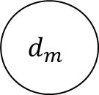

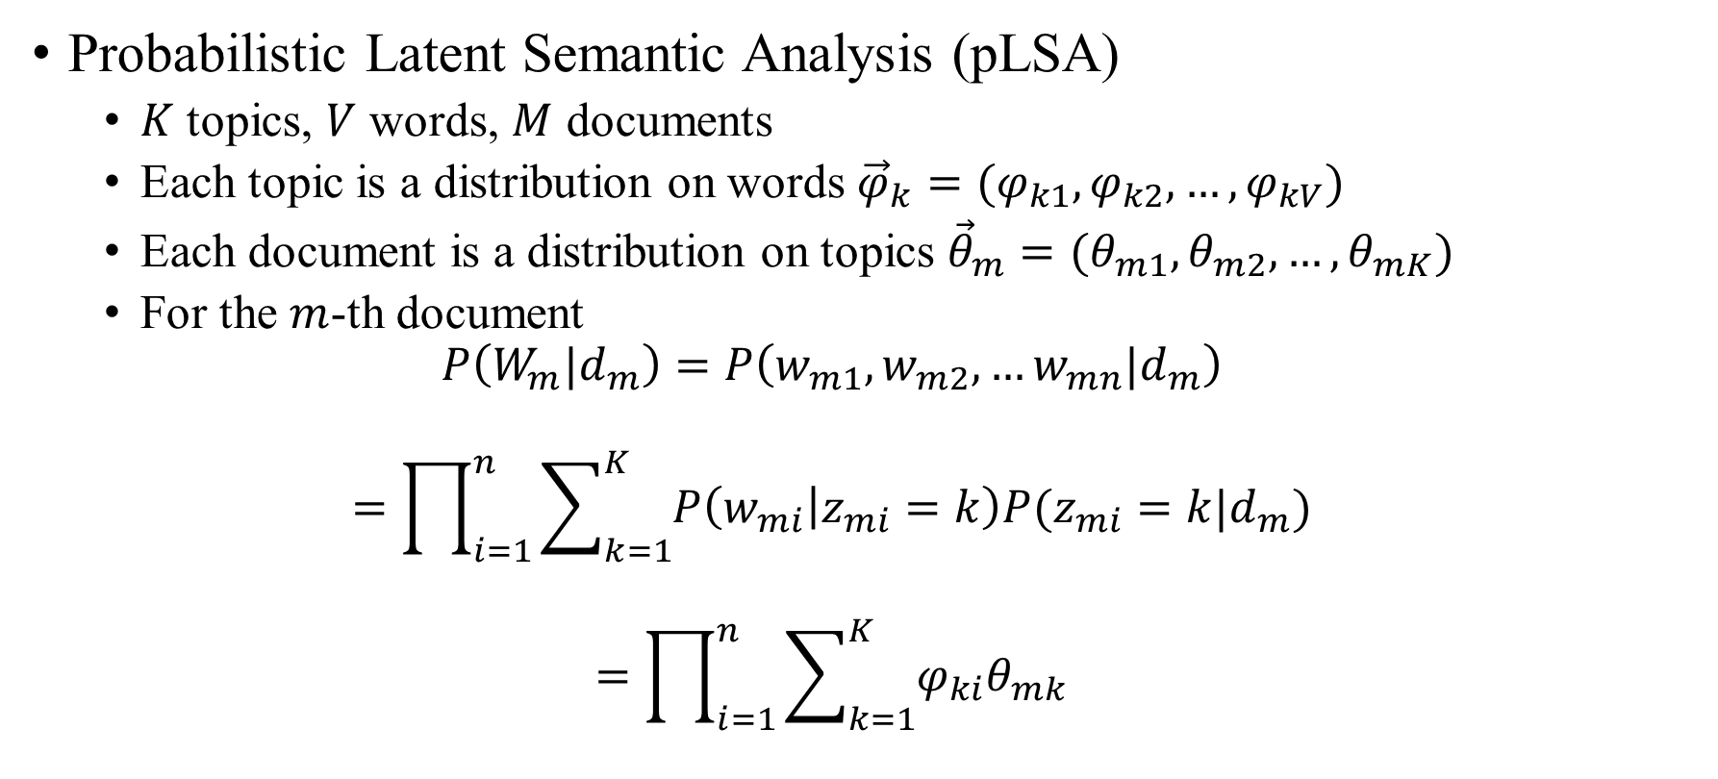
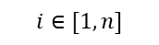
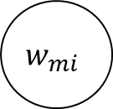
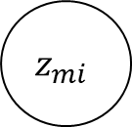
pLSA
Probabilistic Latent Semantic Analysis (pLSA)
$K$ topics, $V$ words, $M$ documents
Each topic is a distribution on words ${\vec{φ}}_{k}=(φ_{k1},φ_{k2},…,φ_{kV})$
Each document is a distribution on topics ${\vec{θ}}_{m}=(θ_{m1},θ_{m2},…,θ_{mK})$
For the $m$-th document
$$P\left(W_{m}|d_{m}\right)=P\left(w_{m1},w_{m2},…w_{mn}|d_{m}\right)$$
$$=\prod_{i=1}^{n}{\sum_{k=1}^{K}{P\left(w_{mi} | z_{mi}=k\right)P(z_{mi}={k|d}_{m})}}$$
$$=\prod_{i=1}^{n}{\sum_{k=1}^{K}{φ_{ki}θ_{mk}}}$$
$$d_{m}$$
$$z_{mi}$$
$$w_{mi}$$
$$i∈[1,n]$$
$$m∈[1,M]$$

Slide 18
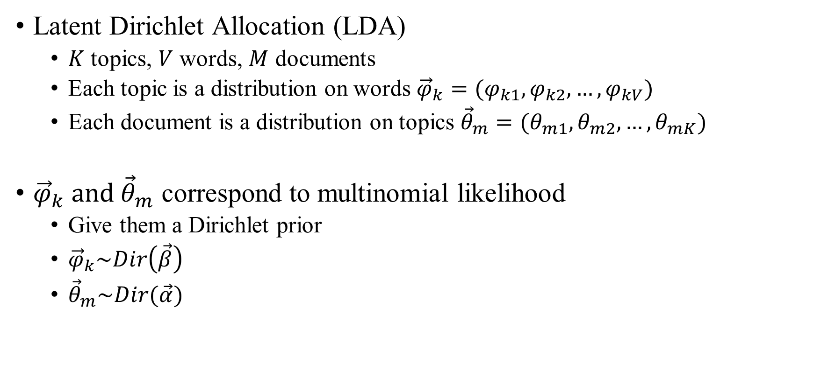
LDA
Latent Dirichlet Allocation (LDA)
$K$ topics, $V$ words, $M$ documents
Each topic is a distribution on words ${\vec{φ}}_{k}=(φ_{k1},φ_{k2},…,φ_{kV})$
Each document is a distribution on topics ${\vec{θ}}_{m}=(θ_{m1},θ_{m2},…,θ_{mK})$
${\vec{φ}}_{k} \text{and} {\vec{θ}}_{m}$ correspond to multinomial likelihood
Give them a Dirichlet prior
${\vec{φ}}_{k}\sim Dir\left(\vec{β}\right)$
${\vec{θ}}_{m}\sim Dir(\vec{α})$

Slide 19
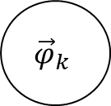
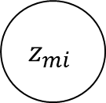
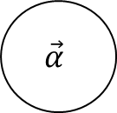
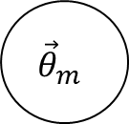
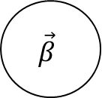
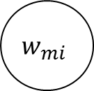
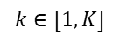
LDA
Graphic Model Representation:
$$\vec{β}$$
$$\vec{α}$$
$${\vec{θ}}_{m}$$
$$z_{mi}$$
$$w_{mi}$$
$${\vec{φ}}_{k}$$
$$i∈[1,n]$$
$$m∈[1,M]$$
$$k∈[1,K]$$
Document Level
Word Level
Topic Level

Slide 20
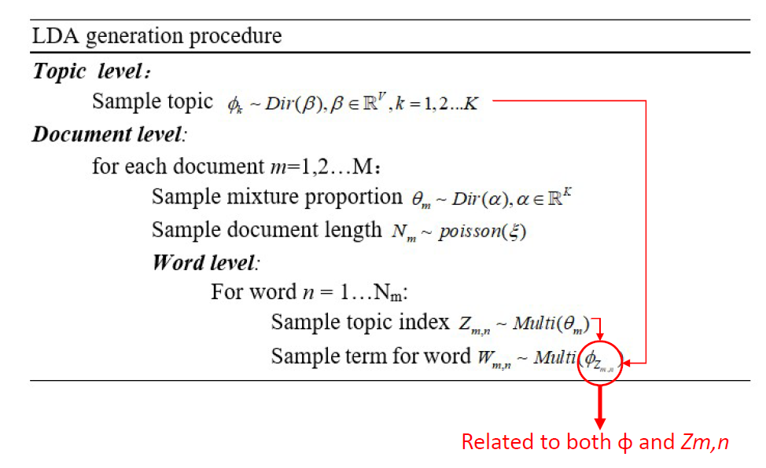
LDA
Generation Procedure

Slide 21
Parameter Inference
Parameter Inference
Gibbs Sampling
Inference
Part III

Slide 22
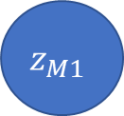



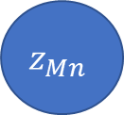
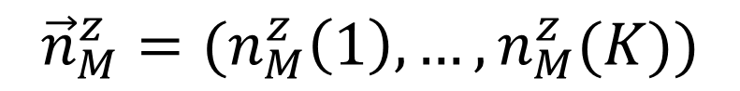
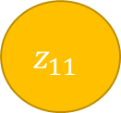
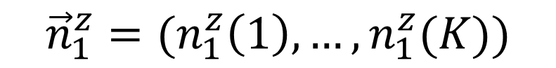
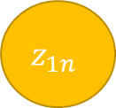


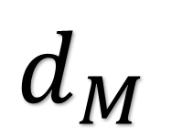
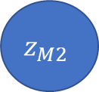
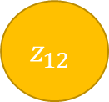

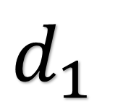
LDA
$$z_{11}$$
$$z_{12}$$
$$z_{1n}$$
$$d_{1}$$
…
$$w_{11}$$
$$w_{12}$$
$$w_{1n}$$
$${\vec{n}}_{1}^{z}=(n_{1}^{z}\left(1\right),…,n_{1}^{z}(K))$$
……
Count Topics
In each document
……
$$z_{M1}$$
$$z_{M2}$$
$$z_{Mn}$$
$$d_{M}$$
…
$${\vec{n}}_{M}^{z}=(n_{M}^{z}\left(1\right),…,n_{M}^{z}(K))$$
$$w_{M1}$$
$$w_{M2}$$
$$w_{Mn}$$

Slide 23
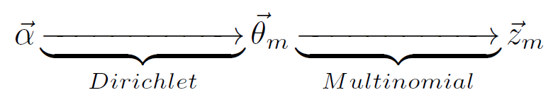
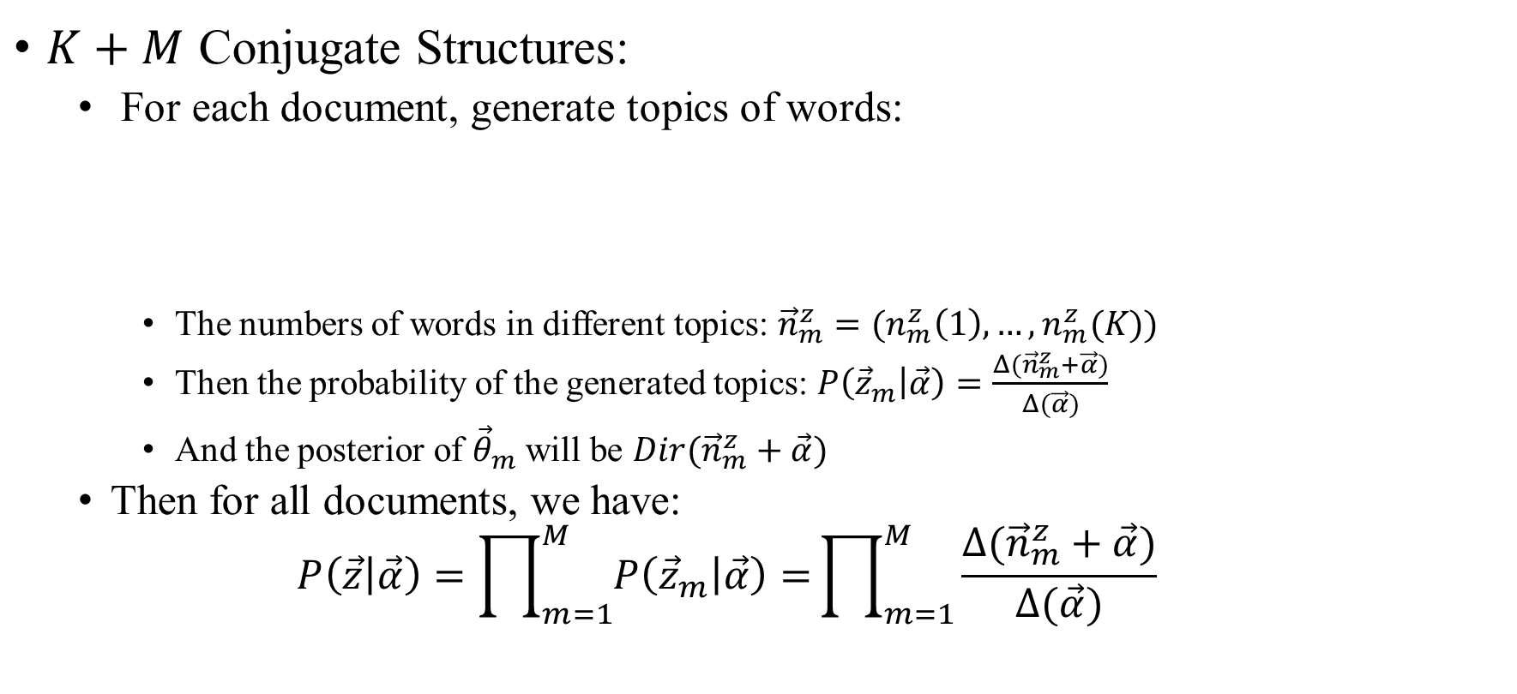

LDA
$K+M$ Conjugate Structures:
For each document, generate topics of words:
The numbers of words in different topics: ${\vec{n}}_{m}^{z}=(n_{m}^{z}\left(1\right),…,n_{m}^{z}(K))$
Then the probability of the generated topics: $P\left({\vec{z}}_{m} | \vec{α}\right)=\frac{Δ({\vec{n}}_{m}^{z}+\vec{α})}{Δ(\vec{α})}$
And the posterior of ${\vec{θ}}_{m}$ will be $Dir({\vec{n}}_{m}^{z}+\vec{α})$
Then for all documents, we have:
$$P\left(\vec{z} | \vec{α}\right)=\prod_{m=1}^{M}{P\left({\vec{z}}_{m} | \vec{α}\right)=}\prod_{m=1}^{M}{\frac{Δ({\vec{n}}_{m}^{z}+\vec{α})}{Δ(\vec{α})}}$$
Need to know $all z_{mi}$
to infer the topic!

Slide 24
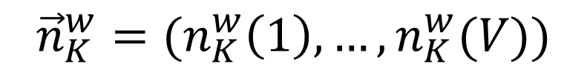
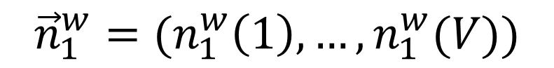
LDA
$$z_{11}$$
$$z_{12}$$
$$z_{1n}$$
$$d_{1}$$
…
$$w_{11}$$
$$w_{12}$$
$$w_{1n}$$
$${\vec{n}}_{1}^{w}=(n_{1}^{w}\left(1\right),…,n_{1}^{w}(V))$$
……
Count Words
In each Topic
……
$$z_{M1}$$
$$z_{M2}$$
$$z_{Mn}$$
$$d_{M}$$
…
$${\vec{n}}_{K}^{w}=(n_{K}^{w}\left(1\right),…,n_{K}^{w}(V))$$
$$w_{M1}$$
$$w_{M2}$$
$$w_{Mn}$$

Slide 25
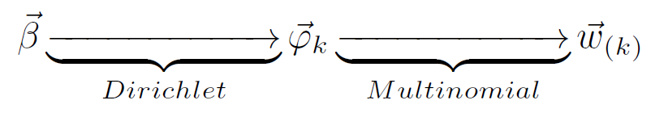
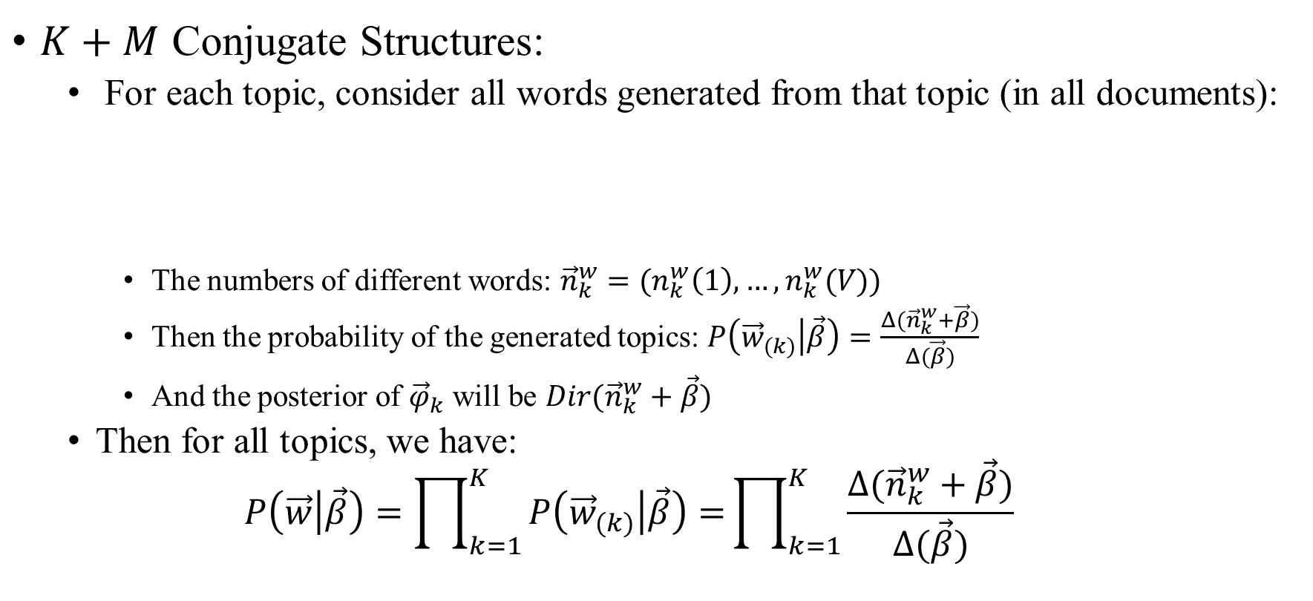
LDA
$K+M$ Conjugate Structures:
For each topic, consider all words generated from that topic (in all documents):
The numbers of different words: ${\vec{n}}_{k}^{w}=(n_{k}^{w}\left(1\right),…,n_{k}^{w}(V))$
Then the probability of the generated topics: $P\left({\vec{w}}_{(k)} | \vec{β}\right)=\frac{Δ({\vec{n}}_{k}^{w}+\vec{β})}{Δ(\vec{β})}$
And the posterior of ${\vec{φ}}_{k}$ will be $Dir({\vec{n}}_{k}^{w}+\vec{β})$
Then for all topics, we have:
$$P\left(\vec{w} | \vec{β}\right)=\prod_{k=1}^{K}{P\left({\vec{w}}_{(k)} | \vec{β}\right)=}\prod_{k=1}^{K}{\frac{Δ({\vec{n}}_{k}^{w}+\vec{β})}{Δ(\vec{β})}}$$

Slide 26
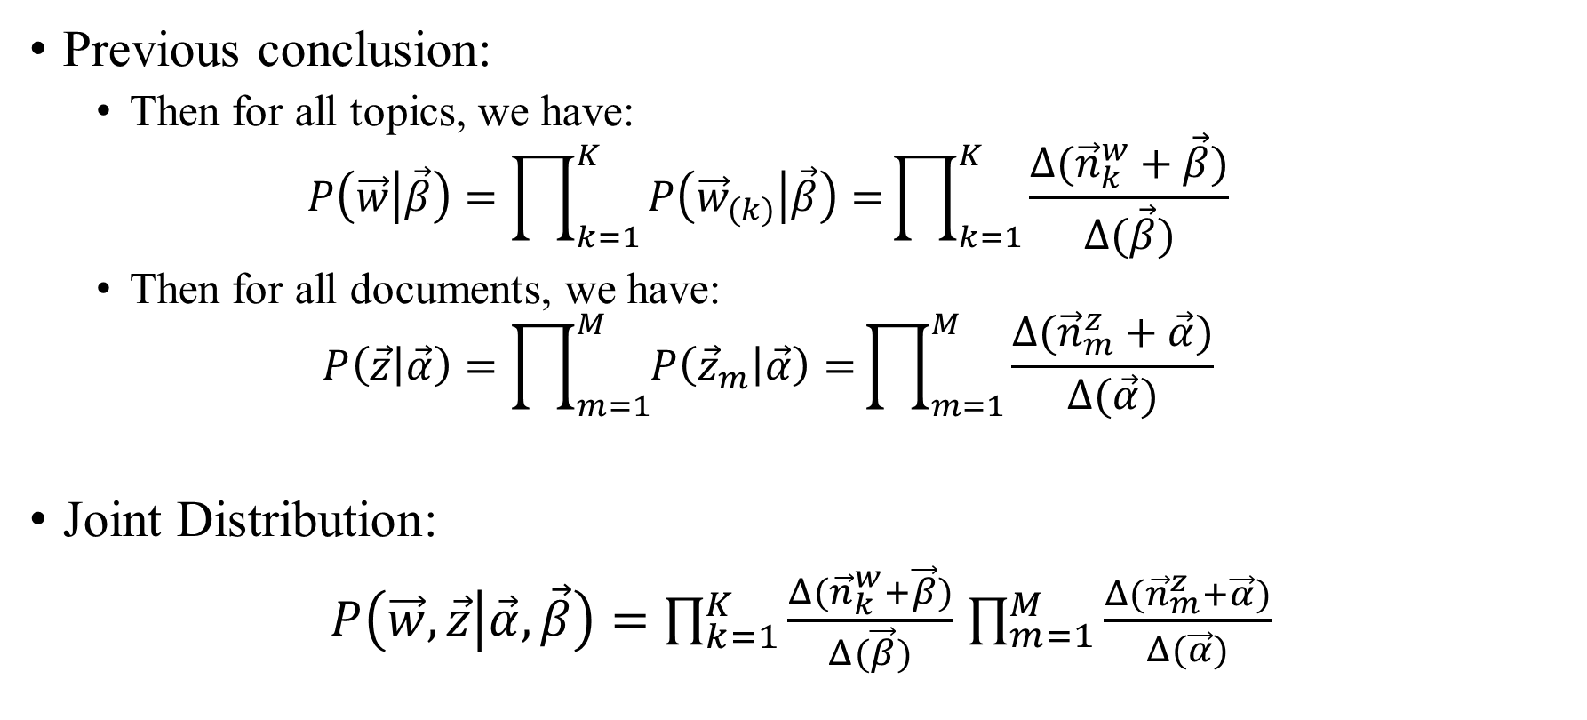
LDA
Previous conclusion:
Then for all topics, we have:
$$P\left(\vec{w} | \vec{β}\right)=\prod_{k=1}^{K}{P\left({\vec{w}}_{(k)} | \vec{β}\right)=}\prod_{k=1}^{K}{\frac{Δ({\vec{n}}_{k}^{w}+\vec{β})}{Δ(\vec{β})}}$$
Then for all documents, we have:
$$P\left(\vec{z} | \vec{α}\right)=\prod_{m=1}^{M}{P\left({\vec{z}}_{m} | \vec{α}\right)=}\prod_{m=1}^{M}{\frac{Δ({\vec{n}}_{m}^{z}+\vec{α})}{Δ(\vec{α})}}$$
Joint Distribution:
$P\left(\vec{w},\vec{z} | \vec{α},\vec{β}\right)=$ $\prod_{k=1}^{K}{\frac{Δ({\vec{n}}_{k}^{w}+\vec{β})}{Δ(\vec{β})}}$ $\prod_{m=1}^{M}{\frac{Δ({\vec{n}}_{m}^{z}+\vec{α})}{Δ(\vec{α})}}$

Slide 27
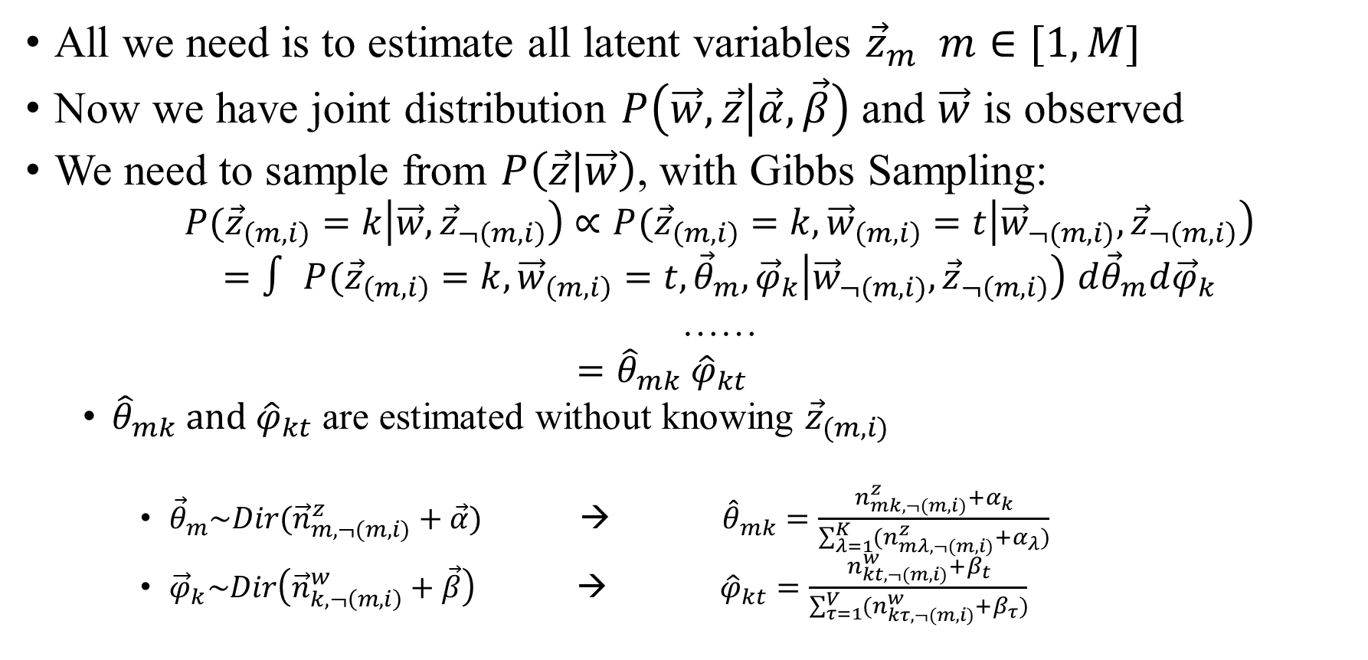
Gibbs Sampling
All we need is to estimate all latent variables ${\vec{z}}_{m} m∈[1,M]$
Now we have joint distribution $P\left(\vec{w},\vec{z} | \vec{α},\vec{β}\right)$ and $\vec{w}$ is observed
We need to sample from $P\left(\vec{z} | \vec{w}\right)$, with Gibbs Sampling:
$P({\vec{z}}_{\left(m,i\right)}=k\left|\vec{w},{\vec{z}}_{¬\left(m,i\right)}\right)∝$ $P({\vec{z}}_{\left(m,i\right)}=k,{\vec{w}}_{\left(m,i\right)}=t\left|{\vec{w}}_{¬(m,i)},{\vec{z}}_{¬\left(m,i\right)}\right)$
$=∫$ $P({\vec{z}}_{\left(m,i\right)}=k,{\vec{w}}_{\left(m,i\right)}=t,{\vec{θ}}_{m},{\vec{φ}}_{k}\left|{\vec{w}}_{¬(m,i)},{\vec{z}}_{¬\left(m,i\right)}\right)$ ${d\vec{θ}}_{m}d{\vec{φ}}_{k}$
……
$$={\hat{θ}}_{mk} {\hat{φ}}_{kt}$$
${\hat{θ}}_{mk} \text{and} {\hat{φ}}_{kt}$ are estimated without knowing ${\vec{z}}_{(m,i)}$
${\vec{θ}}_{m}\sim Dir({\vec{n}}_{m,¬(m,i)}^{z}+\vec{α})$ → ${\hat{θ}}_{mk}=\frac{n_{mk,¬(m,i)}^{z}+α_{k}}{\sum_{λ=1}^{K}{(n_{mλ,¬(m,i)}^{z}+α_{λ})}}$
${\vec{φ}}_{k}\sim Dir\left({\vec{n}}_{k,¬\left(m,i\right)}^{w}+\vec{β}\right)$ → ${\hat{φ}}_{kt}=\frac{n_{kt,¬(m,i)}^{w}+β_{t}}{\sum_{τ=1}^{V}{(n_{kτ,¬(m,i)}^{w}+β_{τ})}}$

Slide 28


Training
Gibbs Sampling:
$$P({\vec{z}}_{\left(m,i\right)}=k\left|\vec{w},{\vec{z}}_{¬\left(m,i\right)}\right)∝{\hat{θ}}_{mk} {\hat{φ}}_{kt}$$
where
${\hat{θ}}_{mk}=\frac{n_{mk,¬(m,i)}^{z}+α_{k}}{\sum_{λ=1}^{K}{(n_{mλ,¬(m,i)}^{z}+α_{λ})}}$
${\hat{φ}}_{kt}=\frac{n_{kt,¬(m,i)}^{w}+β_{t}}{\sum_{τ=1}^{V}{(n_{kτ,¬(m,i)}^{w}+β_{τ})}}$

Slide 29


Inference on a new document
Given a new document $m^{′}$, with Gibbs Sampling:
$$P({\vec{z}}_{\left(m^{′},i\right)}=k\left|\vec{w},{\vec{z}}_{¬\left(m^{′},i\right)}\right)∝{\hat{θ}}_{m^{′}k} {\hat{φ}}_{kt}$$
where
${\hat{θ}}_{m^{′}k}=\frac{n_{m^{′}k,¬(m^{′},i)}^{z}+α_{k}}{\sum_{λ=1}^{K}{(n_{m^{′}λ,¬(m^{′},i)}^{z}+α_{λ})}}$
${\hat{φ}}_{kt}$ is freeze as estimated during training

Slide 30
Evaluation
Perplexity
Perplexity of N-gram
Perplexity of LDA
Part IV

Slide 31

Perplexity – how good our model is
Definition
In NLP, perplexity measures the ability of a model to generalize to unseen data
For a sentence:
$$Perplexity\left(W\right)=P{\left(w_{1}w_{2}…w_{N}\right)}^{−\frac{1}{N}}$$
For a corpus:
$$Perplexity\left(D_{test}\right)=\text{exp}\text{\{−}\frac{\sum_{d=1}^{|D_{test}|}{log⁡(P\left({\vec{w}}_{d}\right))}}{\sum_{d=1}^{|D_{test}|}{N_{d}}}\}$$
Generally, the lower, the better

Slide 32

Perplexity of N-gram
Recall N-gram
Definition: $P\left(w_{i} | w_{i−1},w_{i−2}, …,w_{1}\right)=P(w_{i}|w_{i−1},w_{i−2},…,w_{i−N+1})$
Estimation: $P\left(w_{i} | w_{i−1},w_{i−2},…,w_{i−N+1}\right)=\frac{count(w_{i},w_{i−1},…,w_{i−N+1})}{count(w_{i−1},…w_{i−N+1})}$
Wall Street Journal (Stanford cs124)
N-gram | Unigram | Bi-gram | Tri-gram
Perplexity on Test | 962 | 170 | 109

Slide 33

Perplexity of LDA
For a trained LDA (given the prior and topic number K):
$P\left({\vec{w}}_{d}\right)=\prod_{i=1}^{N_{d}}{(\sum_{k=1}^{K}{P\left(w_{i} | z_{i}=k\right)P(z_{i}=k|d)})}$
$=\prod_{t=1}^{V}{{\left(\sum_{k=1}^{K}{P\left(w_{i}=t | z_{i}=k\right)P\left(z_{i}=k | d\right)}\right)}^{n_{dt}}}$
$=$ $\prod_{t=1}^{V}{{\left(\sum_{k=1}^{K}{φ_{tk}θ_{dk} }\right)}^{n_{dt}}}$
Regard $K,\vec{α},\vec{β}$ as hyper-parameters, select according to
Perplexity on test
Trained Parameter
Inference on the new document

Slide 34
Applications
Document Modeling
Document Classification
Collaborative filtering
Extensions
Part V

Slide 35

Document Modeling
(Blei, 2003) on AP corpus: 16,333 newswire articles

Slide 36

Document Modeling
(Blei, 2003) on AP corpus: 16,333 newswire articles

Slide 37

Document Modeling
Perplexity vs topic number (Blei, 2003)

Slide 38

Document Classification
Binary classification, Reuters-21578 dataset
8000 documents
Low-dimensional representations from LDA (50 topics) for document vs. word features
When proportion of training data used is low…

Slide 39

Collaborative filtering
Similarity → preference

Slide 40

Collaborative filtering
User similarity → preference
Dataset: EachMovie (user: preferred movie choices)
Analogy:
User - document
Movie chosen - words in document
1600 movies - vocabulary
Movie genre - topic
User – Genre $θ$:
Eg. $\text{Mary} \text{preference} = 0.5 \text{Romance} + 0.4 \text{comedy} +0.1 \text{science}\text{−}\text{fiction}$
Movie – Genre $φ$:
Eg. $\text{science}\text{−}\text{fiction}= 0.1 Ready Player One + 0.2 Marvel^{′}s The Avengers +0.3 流浪地球$…

Slide 41

Collaborative filtering
3300 training users; 390 test users
Predictive-perplexity:

Slide 42

Extensions
Drawbacks of LDA model:
Short text topics?
Noisy data
…
Some extension models:
TwitterLDA (Zhao et al. 2011):
Assumption: one topic for one tweet
Labeled-LDA (Ramage et al. 2009, ACL):
Used in document classification
Hierarchical LDA (The et al. 2005):
Find $K$ automaitically
…

Slide 43
References
Blei D M, Ng A Y, Jordan M I. Latent dirichlet allocation[J]. Journal of machine Learning research, 2003, 3(Jan): 993-1022.
Heinrich G. Parameter estimation for text analysis[R]. Technical report, 2005.
Ramage D, Hall D, Nallapati R, et al. Labeled LDA: A supervised topic model for credit attribution in multi-labeled corpora[C]//Proceedings of the 2009 conference on empirical methods in natural language processing. 2009: 248-256.
Teh Y W, Jordan M I, Beal M J, et al. Hierarchical dirichlet processes[J]. Journal of the american statistical association, 2006, 101(476): 1566-1581.
Zhao W X, Jiang J, Weng J, et al. Comparing twitter and traditional media using topic models[C]//European conference on information retrieval. Springer, Berlin, Heidelberg, 2011: 338-349.
靳志辉:《LDA数学八卦》

Slide 44

Monte Carlo Markov Chain
Markov Chain:
Markov Property:
$$P\left(X_{t+1}=x | X_{t},X_{t−1},…\right)=P(X_{t+1}=x|X_{t})$$
Discrete case with $N$ states:
$π_{t}=\left[π_{t}\left(1\right), π_{t}\left(2\right),…π_{t}\left(N\right)\right] \text{where} {1≥π}_{t}\left(i\right)≥0 \text{and} \sum_{i=1}^{N}{π_{t}\left(i\right)=1}$
Transition Probability: $P∈R^{N×N}, P_{ij}=P(X_{t+1}=j|X_{t}=i)$
$π_{t+1}\left(j\right)=\sum_{i=1}^{N}{π_{t}\left(i\right)∗P(X_{t+1}=j|X_{t}=i)}$
$π_{t+1}=π_{t}P$
Stationary distribution of an Markov Chain:
For any non-periodic MC, where any 2 states are connected, we have
$\lim_{n→∞}{{π_{0}P}_{ij}^{n}}=π^{∗}\left(j\right) \text{for} \text{any} π_{0}$
$π^{∗} \text{is} \text{the} \text{only} \text{solution} \text{for} πP=π$

Slide 45

Monte Carlo Markov Chain (MCMC)
An observation:
$$X_{0}\sim π_{0}(x)$$
$$X_{1}\sim π_{1}\left(x\right)$$
$$X_{2}\sim π_{2}\left(x\right)$$
$$……$$
$$X_{n}\sim π_{n}\left(x\right)=π^{∗}\left(x\right)$$
$$X_{n+1}\sim π^{∗}(x)$$
Start from $x_{0}$, following the MC, we have $x_{0},x_{1},…,x_{n},x_{n+1},…$, then $x_{n},x_{n+1},…$ are samples from $π^{∗}(x)$
Hard to sample from a distribution $p(x)$, why not find a MC, whose stationary distribution is $p(x)$ ? → MCMC

Slide 46

Monte Carlo Markov Chain (MCMC)
MCMC:
Find a MC with transition matrix $Q$, with stationary distribution $p(x)$
An naïve method:
Let $p\left(i\right)q\left(i→j\right)=p\left(j\right)q(j→i)$ （细致平稳性）
Then $p_{t+1}\left(i\right)=\sum_{j=1}^{N}{p\left(j\right)q(j→i)}=\sum_{j=1}^{N}{p\left(i\right)q(i→j)}=p\left(i\right)\sum_{j=1}^{N}{q\left(i→j\right)}=p(i)$
Which means $p=pQ$
Generalization:
For any MC, $p\left(i\right)q\left(i→j\right)≠p\left(j\right)q(j→i)$
Do some edition: $p\left(i\right)q\left(i→j\right)α(i,j)=p\left(j\right)q\left(j→i\right)α(j,i)$
Easy to see that: $α\left(i,j\right)=p\left(j\right)q\left(j→i\right)$ and $α\left(j,i\right)=p\left(i\right)q\left(i→j\right)$
A new MC with transition $Q^{′}, \text{where} q^{′}\left(i→j\right)=q\left(i→j\right)α(i,j)$

Slide 47


Monte Carlo Markov Chain (MCMC)
MCMC:
Generalization:
Easy to implement a MC with trainsition $Q$
But how about ${ Q}^{′}, \text{where} q^{′}\left(i→j\right)=q\left(i→j\right)α(i,j)$
Treat $α\left(i,j\right)$ as acceptance rate!

Slide 48

Gibbs Sampling
MCMC in high-dimensional:
$q^{′}\left(\vec{x}→\vec{y}\right)=q\left(\vec{x}→\vec{y}\right)α(\vec{x}→\vec{y})$, always with a low acceptance rate!
What if we only change one element in each update?
Consider 2-dimensional case: $A\left(x_{1},y_{1}\right), B(x_{1},y_{2})$
$p\left(x_{1},y_{1}\right)p\left(y_{2} | x_{1}\right)=p\left(x_{1}\right)p\left(y_{1} | x_{1}\right)p\left(y_{2} | x_{1}\right)$
$p\left(x_{1},y_{2}\right)p\left(y_{1} | x_{1}\right)=p\left(x_{1}\right)p\left(y_{2} | x_{1}\right)p\left(y_{1} | x_{1}\right)$
So $p\left(x_{1},y_{1}\right)p\left(y_{2} | x_{1}\right)=p\left(x_{1},y_{2}\right)p(y_{1}|x_{1})$
Gibbs Sampling:
Need to sample from $p(x_{1},x_{2},x_{3},…,x_{n})$
In each update, only change one element $x_{i}$
Sample from $p(x_{i}|x_{1},x_{2},…x_{i−1},x_{i+1},…x_{n})$

Slide 49
Gibbs Sampling

